Slide 1

Exploratory Data Analysis
Cab Company Investment Analysis
15th April 2025

Slide 2

AGENDA
EXECUTIVE SUMMARY
PROBLEM STATEMENT
APPROACH
EDA
EDA SUMMARY
RECOMMENDATIONS

Slide 3

EXECUTIVE SUMMARY
XYZ is considering investing in one of two U.S. cab companies: Pink Cab or Yellow Cab
Analyzed ~849K records across rides, customers, payments, and cities
Objective: Identify the better-performing company using data-driven insights
Approach: Cleaned & merged data, conducted EDA, tested 7 key business hypotheses
Assumptions: Income = monthly USD, dates standardized, consistent operations
Key Insight: Yellow Cab leads in profit, distance, retention & urban market share
Outcome: Recommendation backed by clear, quantifiable analysis
“This analysis offers XYZ a reliable and quantifiable basis for investment decision-making, minimizing risk and maximizing ROI potential.”

Slide 4
PROBLEM STATEMENT INVESTMENT DECISION CHALLENGE: PINK CAB VS. YELLOW CAB
What problem are we trying to solve, and why is it important?
Client XYZ is planning to invest in the U.S. cab industry
Two potential targets: Pink Cab and Yellow Cab
Due to market competitiveness, XYZ seeks data-driven clarity before making a decision
Internal strategy requires understanding each company’s profitability, customer engagement, and market presence
The challenge: Identify which company offers higher growth potential and investment return

Slide 5
APPROACH
How did we go about solving the problem?
Loaded and cleaned 4 datasets covering rides, customers, cities, and payments
Standardized data types (e.g., dates, currency, numeric formatting)
Merged datasets into a unified table with ~849K records
Performed Exploratory Data Analysis (EDA) to explore trends and patterns
Formulated and tested 7 business hypotheses focused on profit, retention, and customer behavior
Extracted key insights and visualizations to support investment recommendations
Data Cleaning
Merging
EDA
Hypothesis Testing
Insights
Recommendation

Slide 6
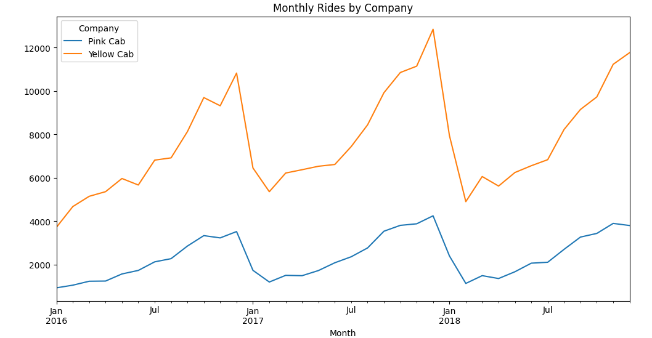
EXPLORATORY DATA ANALYSIS EDA INSIGHTS
How Many Rides Each Company Got?
Yellow Cab consistently leads in monthly ride volume over 3 years
Both companies show strong seasonality, with demand peaking in December
Yellow Cab’s ride volume is 2–3x higher, indicating broader customer reach
Seasonal spikes suggest opportunity for targeted marketing & pricing strategies
Consistent demand makes Yellow Cab more attractive for stable, scalable investment

Slide 7
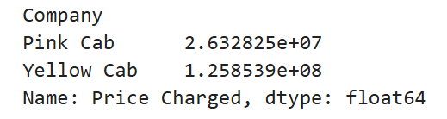
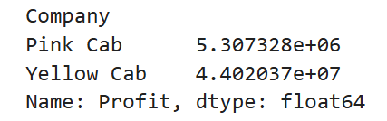
EXPLORATORY DATA ANALYSIS EDA INSIGHTS
Financial Performance: Revenue & Profit Comparison
Yellow Cab generated nearly 5x more revenue than Pink Cab across the same 3-year period
Profit gap is even wider—Yellow Cab achieved over 8x more total profit
Indicates higher operational efficiency and a more profitable pricing model
Suggests that Yellow Cab can generate greater returns per dollar invested
Strong financial performance reinforces Yellow Cab as the strategic investment choice

Slide 8
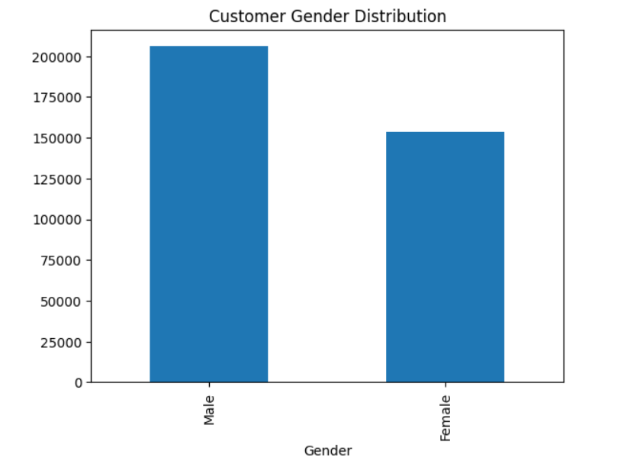
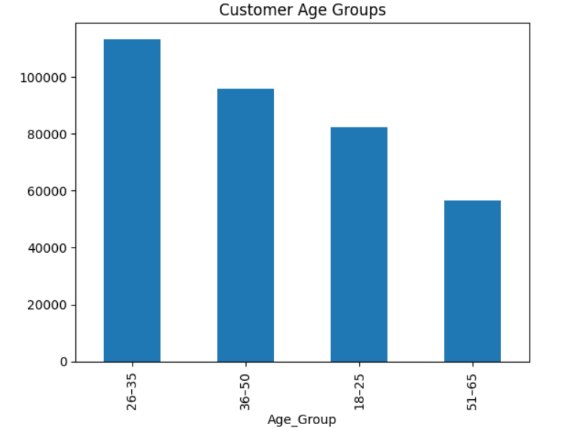
EXPLORATORY DATA ANALYSIS EDA INSIGHTS
Understanding Who Our Riders Are – Age & Gender Insights
The 26–35 age group is the largest user base, followed by 36–50 and 18–25
Customers over 50 form the smallest user segment, showing low senior adoption
The platform appeals most to young working professionals
Suggests potential for age-specific campaigns (e.g., app convenience, lifestyle branding)
Gender and age trends together show balanced yet youthful customer demographics, valuable for long-term customer lifetime value (CLV)

Slide 9
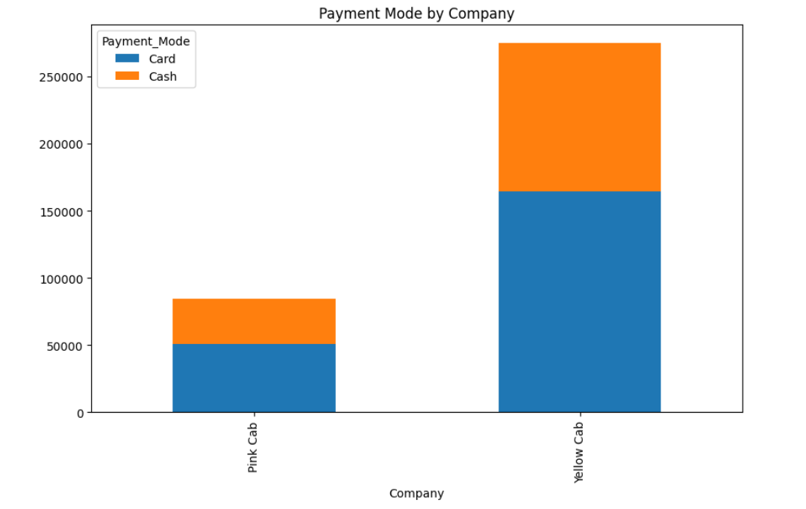
EXPLORATORY DATA ANALYSIS EDA INSIGHTS
How Customers Pay – Payment Mode Distribution
Card payments dominate (~60%) for both companies, suggesting digital adoption
Cash remains significant (~40%), requiring support for offline transactions
Yellow Cab processes far more payments overall, reinforcing its scale advantage
Similar mode split indicates no major behavioral difference in customer base
Confirms both companies are well-positioned for digital payment ecosystems, but Yellow Cab handles more transactions with the same infrastructure

Slide 10
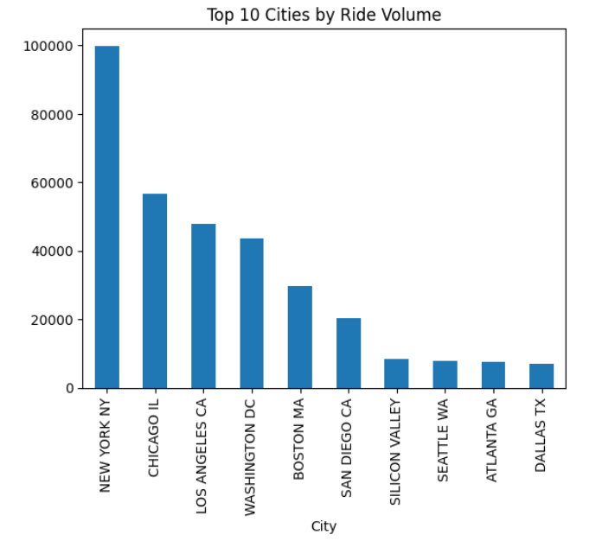
EXPLORATORY DATA ANALYSIS EDA INSIGHTS
Market Penetration: High-Demand Urban Areas
New York leads by a large margin, followed by Chicago and Los Angeles
Ride volume is heavily concentrated in top-tier urban markets
These cities likely contribute most of the revenue and customer activity
Investing in the company with a strong presence in these cities ensures greater market leverage
Understanding demand geography helps XYZ prioritize city-level strategies for expansion or optimization

Slide 11
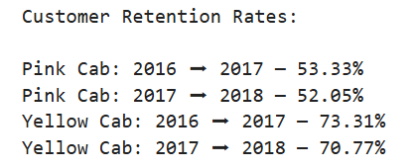
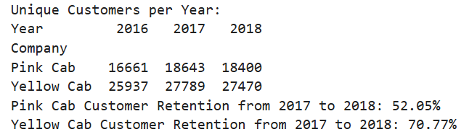
EXPLORATORY DATA ANALYSIS EDA INSIGHTS
How Many Customers Stay? Retention: Year-Over-Year
Yellow Cab retains 70%+ of customers, significantly outperforming Pink Cab (~52%)
Yellow Cab also has a larger customer base each year, compounding its growth potential
High retention implies better customer experience, satisfaction, and trust
Lower churn means reduced acquisition costs and higher customer lifetime value (CLV)
Retention strengthens Yellow Cab's case as a long-term, stable investment opportunity

Slide 12
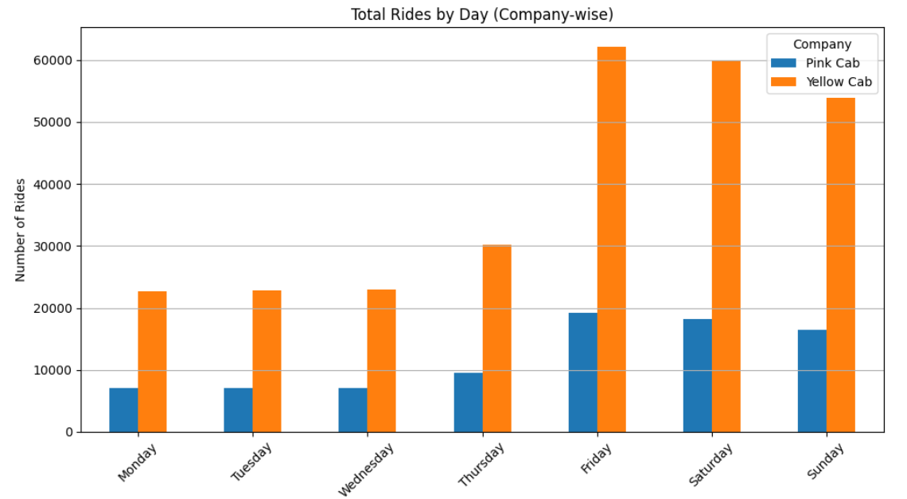
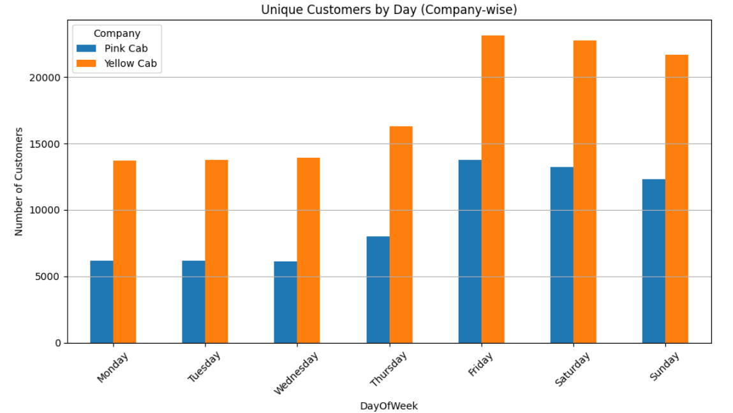
EXPLORATORY DATA ANALYSIS EDA INSIGHTS
Customer Traffic Patterns By Day Of The Week
Yellow Cab dominates ride volume and customer count on all days of the week
Weekends (Fri–Sun) show the highest demand, highlighting prime time for revenue
Suggests value in weekend-focused promotions, surge pricing, or fleet scaling
Stable weekday traffic enables consistent revenue and workforce scheduling
These insights support smarter capacity planning, marketing, and customer engagement strategies

Slide 13
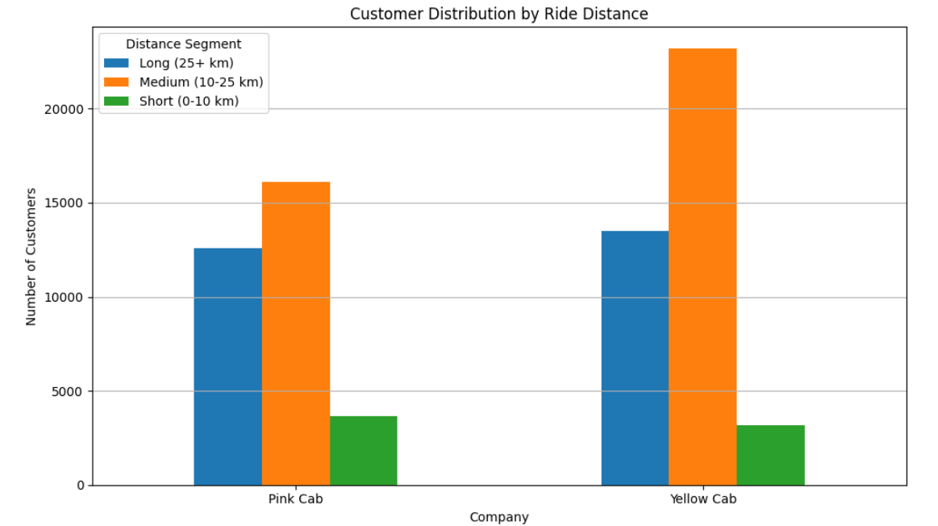
EXPLORATORY DATA ANALYSIS EDA INSIGHTS
Trip Distance Preferences Across Companies
Majority of customers prefer medium-distance rides (10–25 km)
Yellow Cab leads in both medium and long-distance segments, reflecting broader route coverage
Pink Cab has slightly more short-distance riders, suggesting a more local/urban usage pattern
Distance distribution affects trip pricing, fuel usage, and average profit per ride
Yellow Cab’s dominance in longer trips indicates higher revenue per customer and wider service capability

Slide 14
EDA SUMMARY KEY TAKEWAYS
What Data Reveals – EDA Summary
Yellow Cab dominates ride volume every month and day of the week—indicating consistent, scalable demand
It generated 5× more revenue and 8× more profit than Pink Cab, with higher efficiency per trip
Customer retention is significantly stronger for Yellow Cab (~71% vs. 52%), highlighting brand loyalty
Yellow Cab covers 225% more distance than Pink Cab, signaling wider operational presence
Both companies serve a balanced demographic, but Yellow Cab captures more high-value ride segments
Demand spikes on Fridays and weekends, offering revenue-boosting opportunities
Yellow Cab is dominant in all top 10 U.S. cities, aligning with high-density market potential
"Yellow Cab consistently outperforms Pink Cab across every key metric—from financials to customer loyalty—making it a more scalable and investable opportunity."

Slide 15
RECOMMENDATIONS
Investment Decision – Based on Data Insights
Based on the overall exploratory data analysis (EDA), we recommend XYZ should invest in Yellow Cab.
Why Yellow Cab?
Generates 5× more revenue and 8× more profit than Pink Cab
Serves ~1.5x more unique customers, with 71% retention rate (vs. 52%)
Covers 225% more distance, reflecting greater operational scale
Dominates in all top 10 U.S. cities, offering strong urban market leverage
Captures more medium and long-distance rides, increasing trip value
Shows consistent demand across days, with high activity on weekends
Well-positioned for growth in both digital and offline payment channels
"Yellow Cab offers a data-validated path to long-term growth and profitability, making it the most strategic investment opportunity for XYZ."

Slide 16
THANK
YOU

